Slide 1
Pablo Picasso’s Red and Blue Period

Slide 2
Picasso’s Blue Period (1901-1904)
In 1901, Picasso appeared to have entirely abandoned realism. This is particularly clear in his preference for color, which evolved from naturalistic hues to cooler tones. This change in pigment lasted until 1904, and is now characterized as the artist's Blue Period.
Art of this period is somber in both color and in subject matter—an approach likely caused by depression due to a close friend's death.
Picasso's Blue Period lasted until 1904. At this time, less solemn subjects and a warmer color scheme began to pop up in his paintings.

Slide 3
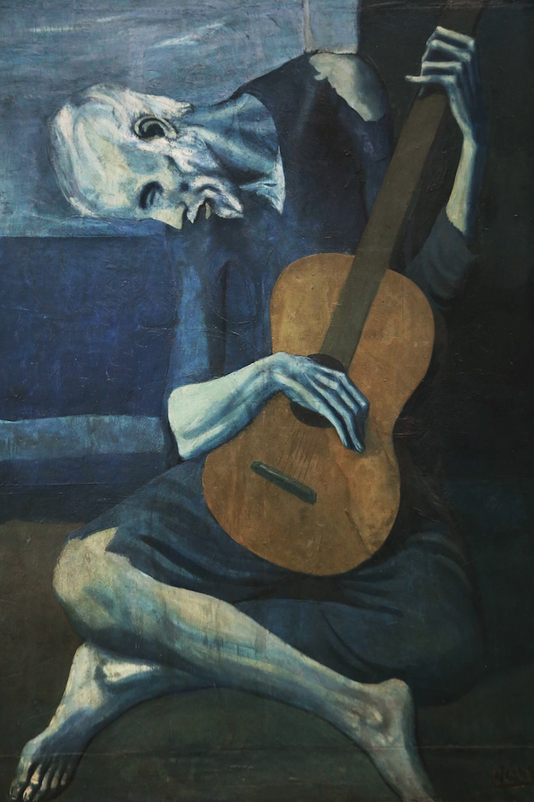
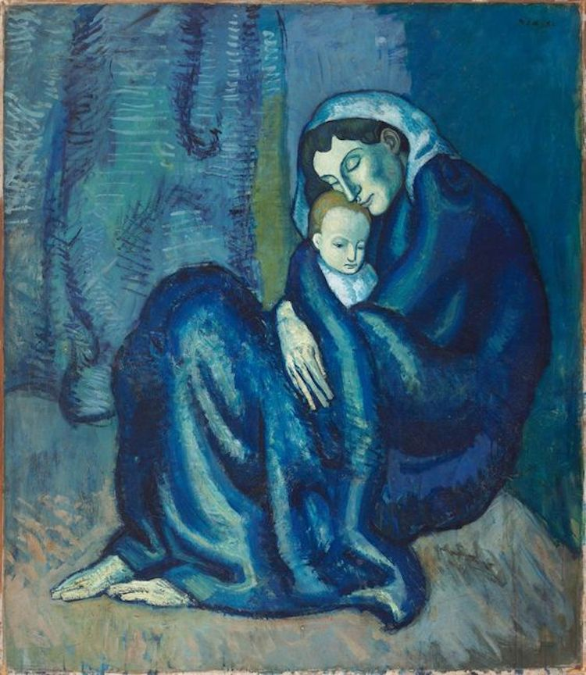
The Old Guitarist (ca. 1903-1904)
Mother and Child (1901)

Slide 4
Picasso’s Red Period (1904-1906)
As Picasso transitioned to his Rose Period in 1904, he continued to depict figures in his characteristically painterly style. While blue tones are still present in these paintings, they are contrasted by warmer shades. Similarly, after moving to Montmartre, a Bohemian district in Paris, he shifted his focus from individuals living in despair to entertainers, including harlequins, acrobats, and other circus performers.

Slide 5
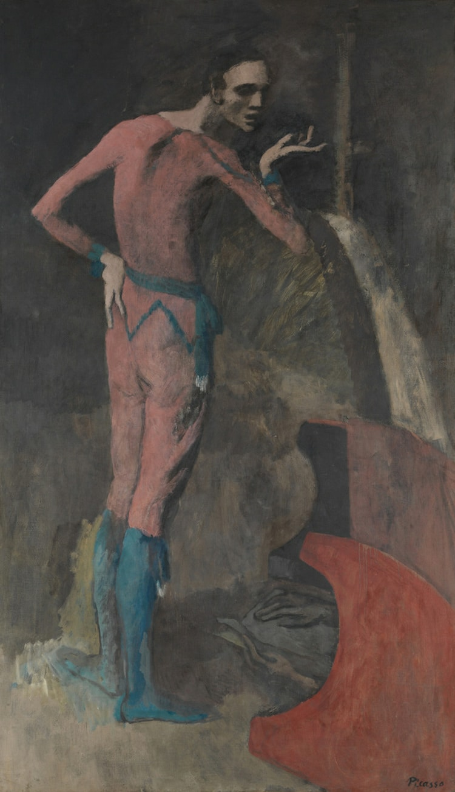
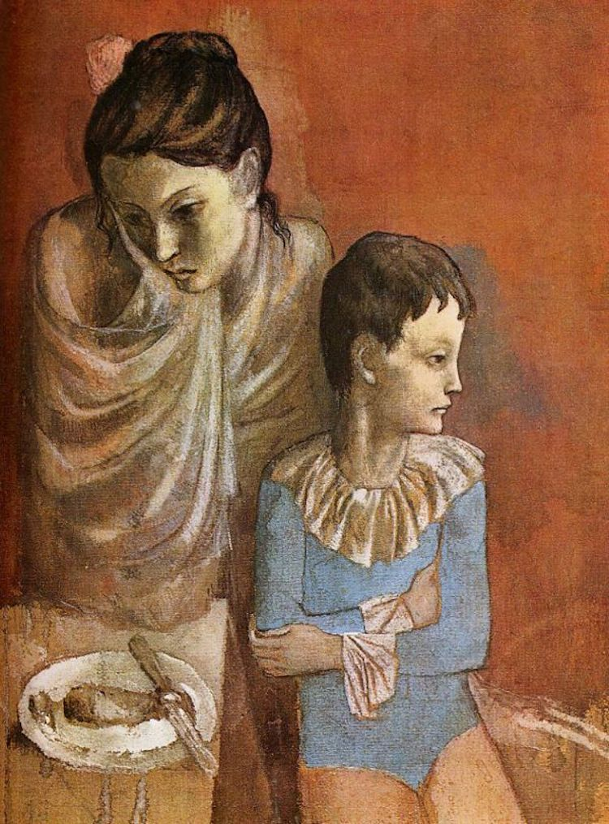
The Actor (ca. 1904-1905)
Mother and Child, Acrobats (ca. 1904-1905)

Slide 6
https://mymodernmet.com/pablo-picasso-periods/

